Slide 1
CST8117 Cross Platform Web Design
Assignment 2
The Style Guide

Slide 2
The Style Guide
Welcome to Puppedia
Roles:
Team leader: Steven
Frontend UI designer: Lynn
Frontend designer: Jacky
Frontend developer: Steven

Slide 3
The Client of Website
Design and build Puppedia website.
The target customer is:
Dog lovers
Our slogan:
Your dog decision guide

Slide 4
The Style
Our website is inspired by Wikipedia but is designed specifically for dog enthusiasts. As our slogan states, we aim to assist people considering getting a dog by providing information about various dog breeds. Users can also find breed-specific advice on our site.
We chose colors that closely resemble the fur colors of dogs as the theme for our site. Contract are created with different colors applied between sections.

Slide 5


1. Typography - Header
Font: “Bree Serif”
Font size: 34px (<h1> tag)
Font weight: bold
Color:
#13348E (nav text)
#000000 (section header)

Slide 6
1. Typography - Content
Font: “PT Sans”
Font size: 16px (<p> tag)
Font weight: regular
Color: #000000

Slide 7

2. Logotypes
Size: (1200 x 1200 px)

Slide 8
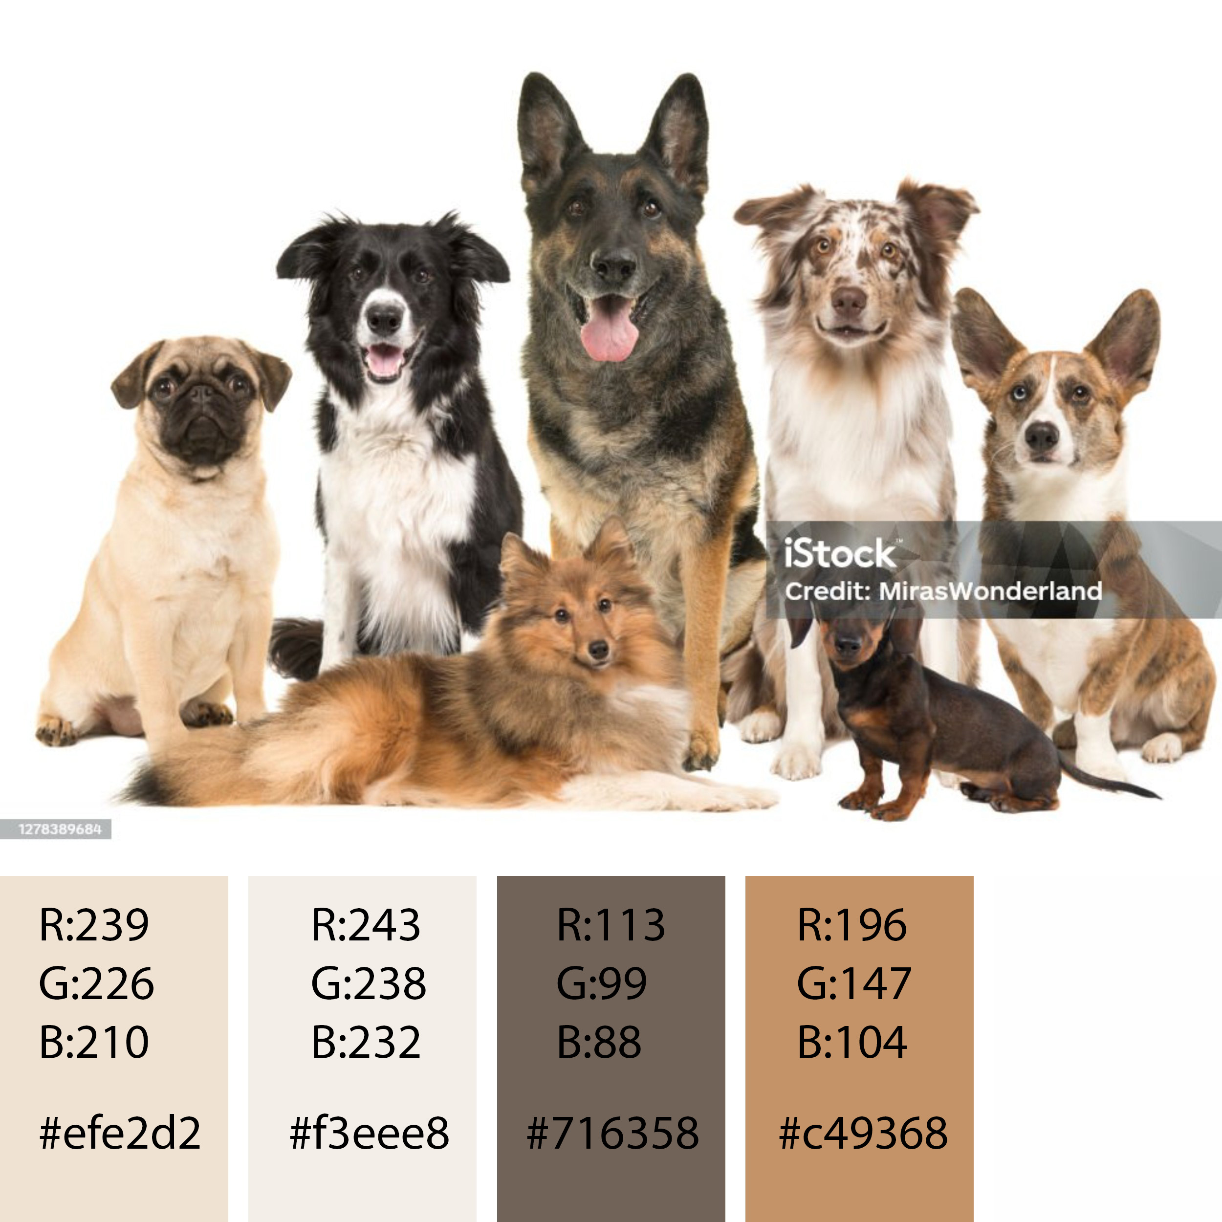
3. Color palette

Slide 9
3. Color palette (main theme)
#6c584c
Pagination hover status
Pagination active status
#8a817c
Dog card text
Pagination static status
#efe2d2
Dog advice container background color
#f3eee8
Body background color
#f1f2be
Dog cards’ background color
#f6f6f2
Section div background color
#6c584c
#8a817c
#efe2d2
#f3eee8
#f1f2eb
#f6f6f2

Slide 10
3. Color palette (Individual elements)
#3273F6
Form slider and buttons color
#ffd700
Dog parameter stars colors
#13348e
Nav items color
#F64C72
Nav items and dog cards’ hover status color
#13348e
#3273F6
#F64C72
#ffd700

Slide 11
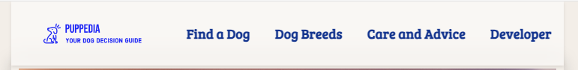
4. Platform - Responsive layout
Responsive layout rules
Fixed Nav in large monitors (50px)

Slide 12
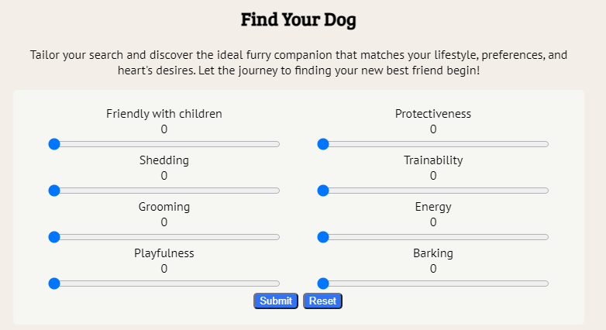
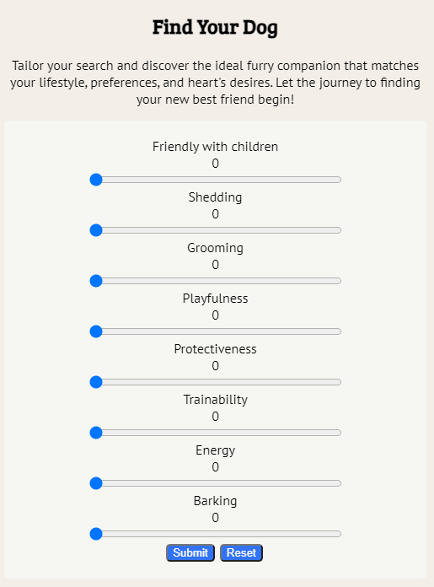
4. Platform - Responsive layout
Form in one column in mobile devices
(max-width: 610px)
Responsive layout rules
Form from two column in large monitors

Slide 13
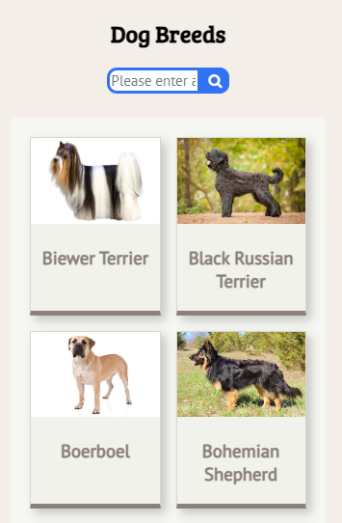
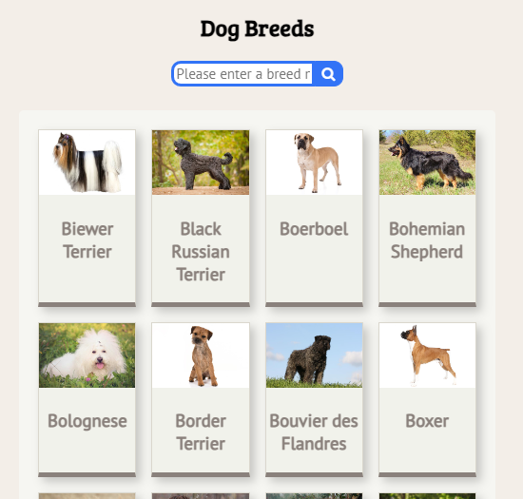
4. Platform - Responsive layout
Dog Breeds session with 2 to 8 grid in small mobile
Responsive layout rules
Dog Breeds session with 4 to 4 grid in large monitors

Slide 14
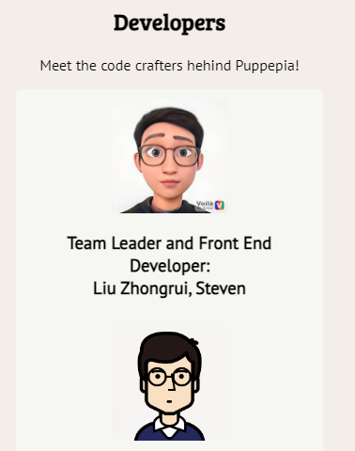
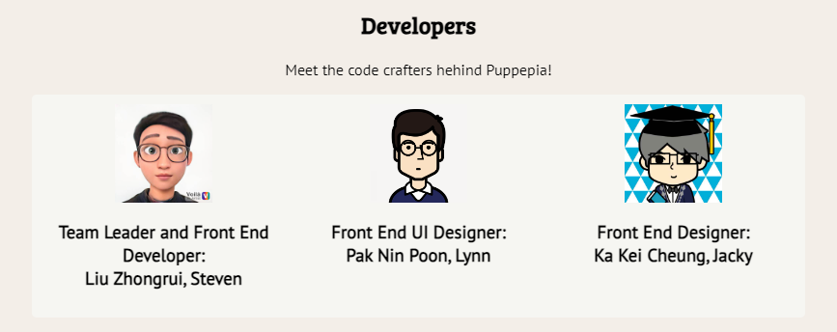
4. Platform - Responsive layout
Responsive layout rules
Developer session with grid (1fr) in large monitors
Developer session with grid (3, 1fr) in large monitors

Slide 15
5. Semantic design guide
Index page – signature div design guide
div signature font color sequence
div signature background color sequence
Text (static status):
Background div:
Section div:
Advice section div
(a different color for this dynamic section):
#13348e
#8a817c
#f3eee8
#f1f2eb
#efe2d2
Text (hover status):
#F64C72
#6c584c

Slide 16

5. Semantic design guide
Header and Nav
The navigation bar utilizes a white background to highlight the blue logo. Nav items incorporate a different shade of blue for consistency.
A darker blue, in contrast to the light blue of the logo, is used for the navigation text to avoid it resembling a hyperlink too closely.

Slide 17
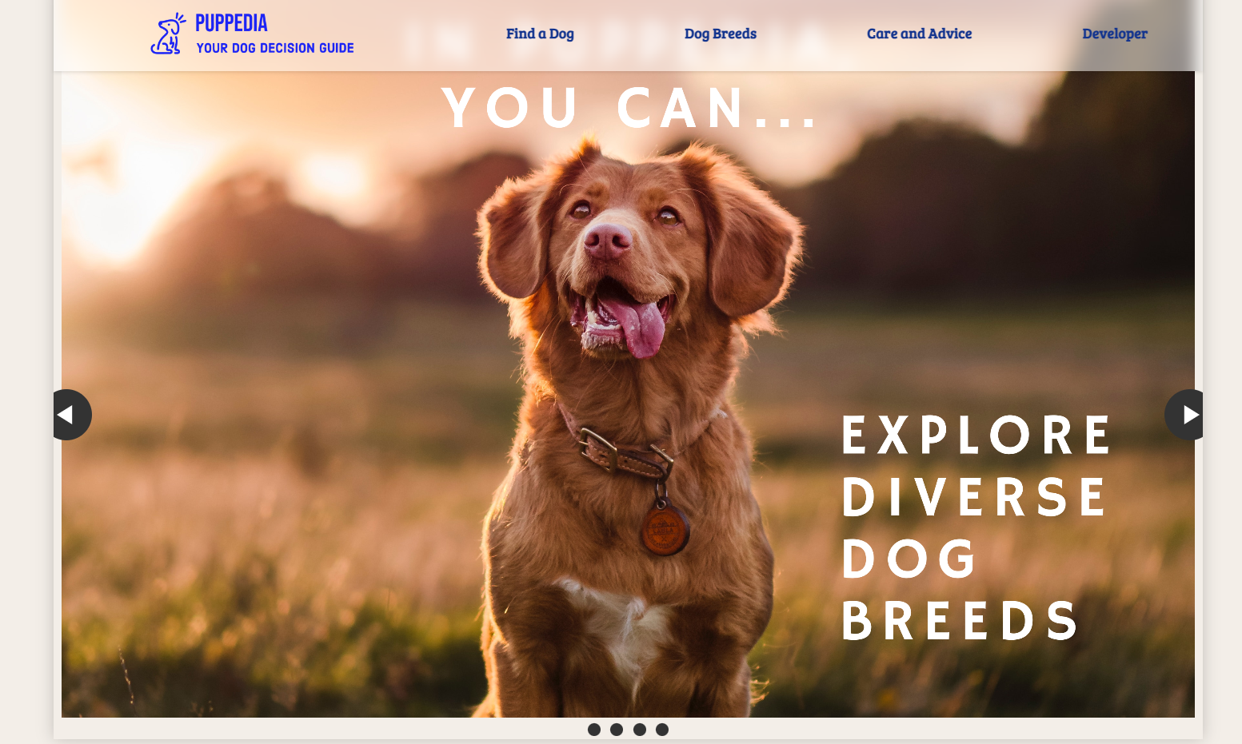
5. Semantic design guide
Photo Slideshow
A slideshow on the main page designed to capture the attention of visitors with photos of dogs. Text has been added to the images to make them informative.

Slide 18
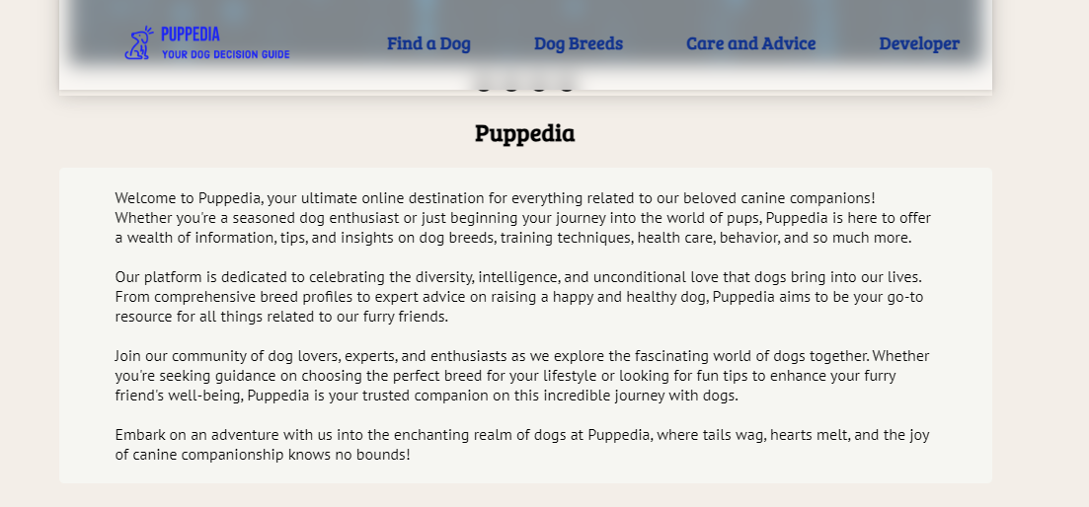
5. Semantic design guide
Intro Div
Puppedia's intro section is positioned as the second div on the page. It provides users with all the information they need before exploring the rest of the page. Each section is distinguished by a different color from the background, serving as an indicator of where the div begins and ends.

Slide 19
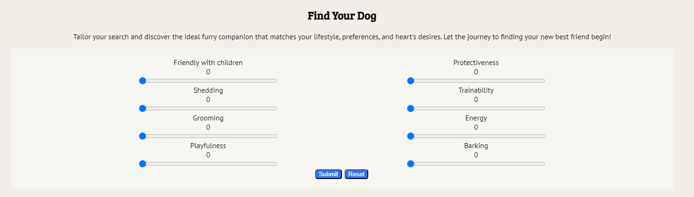
5. Semantic design guide
Main section
Each div has a brief description of its content.
1. Find the Dogs
We chose a slider over a drop-down menu for its intuitiveness. Users can customize their parameters when selecting dog breeds.

Slide 20
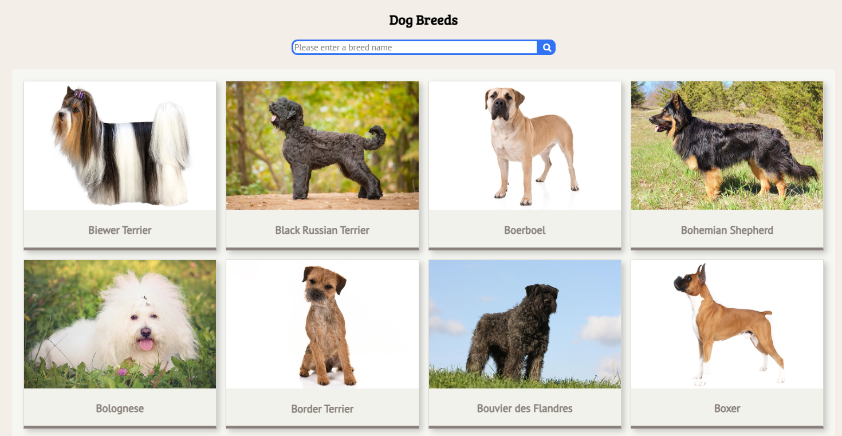
5. Semantic design guide
Main section
2. Dog Breeds
Users can also type in the name of a specific breed in the search bar and directly look for the introduction of that breed if they already have a breed in mind. The results will be dynamically displayed below.
The breeds are displayed in a card style.
When clicked, a 'Care & Advice' div will be shown below.
Detailed information, such as characteristics
and keeping advice, can be found in this div.

Slide 21
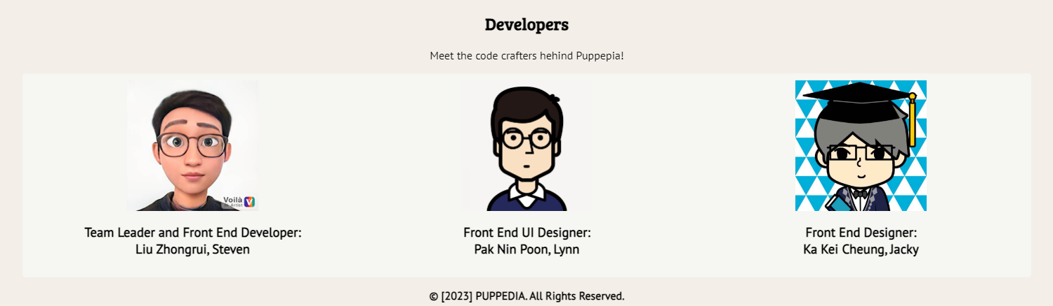
5. Semantic design guide
Main section
3. Developers
An overview of the role of each developers

Slide 22
6. Website Map
Homepage
Dog Breeds
Care and Advise
Developer
Fing a Dog

